Slide 1

[Samsung PRISM] End Review Report
AI ML Dataset creation and classification of unit Test cases
Team
College Professor(s):
1. Dr. Anusuya K V / kva.ece@psgtech.ac.in
2. Dr. S Suriya / ss.cse@psgtech.ac.in
Students:
Bhavani A / 21Z303 / 21z303@psgtech.ac.in / bhavania2003@gmail.com
Prathibha G / 21Z332 / 21z332@psgtech.ac.in / prathibha5112003@gmail.com
Shrinidhi S / 21Z352 / 21z352@psgtech.ac.in / shri06math@gmail.com
Supriya K / 21z360 / 21z360@psgtech.ac.in / supriyakanagasundaram@gmail.com
Department: BE Computer Science and Engineering
Date: 2 April 2024

Slide 2




AI, ML | Dataset creation and classification of Unit test cases
Problem Statement
Whenever developer writes a code we need to check the code covers all the necessary cases and don’t crashes on production, so to avoid these issues tester writes test cases to check the quality of code before deploying it on production.
Test cases specially Negative test cases are very important to avoid any crashes or serious bug in code.
Objective of this work let is to create the dataset of Positive and Negative test cases(Python) and Automate the process of classifying test cases into Positive or Negative Using AI.
Team would be required to create dataset from open source and build AI Algorithm to classify the test cases into Positive or Negative.
Work-let expected duration – 6 months
3-5
Members
Expectations
Create dataset for Python Language which should consist :
function code,
corresponding test case and
class of test case (Positive or Negative)
Augment the dataset to increase the dataset and balance positive and negative class count
Verification and Validation of dataset classes
Find and Train Suitable Language model/Custom Generative model (BERT/GPT family LLMs) for classification task
Tune the hyper-parameters to get Accuracy>60% and F1 Score>50%
Training/ Pre-requisites
Hands-on Python
Knowledge of writing test cases for python function
Knowledge of Deep Learning
Knowledge of NLP and Large Language models
Objective
Input Data
(Function : Test Case)
Language Model
Output
(Test case is Positive or Negative)
Additional Documentation:
https://brightsec.com/blog/unit-testing/
https://www.geeksforgeeks.org/positive-vs-negative-vs-destructive-test-cases/
https://www.softwaretestinghelp.com/positive-and-negative-test-scenarios/
https://arxiv.org/pdf/1910.03474.pdf
“Text Classification via Large Language Models” - https://arxiv.org/pdf/2305.08377.pdf
Kick Off < 1st Month >
Understanding of Function code writing and corresponding Test case classes
Understand the NLP Basics like Text Embedding, Tokens, vocabulary, Encode-Decoder, Transformer
Milestone 1 < 2nd Month >
Open source dataset preparation – Find any open source dataset , Data scraping
Create dataset from Open source Language model like ChatGPT, BARD or LLaMA etc.
Automating the labelling of test cases
Milestone 2 < 4th Month >
Verification and validation of Dataset classes
Split The Dataset into Train, Validation and Test set keeping class balanced
Develop ML pipeline for text (Function + Test case) classification using Language model like BERT/GPT
Closure < 6th Month >
Iterative Tuning of hyper parameters and
Iterative testing the models and get the best model among experiments
Develop prediction script to run in terminal- Given Function-Test case , It should classify Negative or Positive.
N Devaraj, Lead Engineer
devaraj.n@Samsung.com
+91-9663795469
Anandamay, Sr.Chief Engineer
anandamay.c@Samsung.com
+91-7411072266
Notes:
-

Slide 3
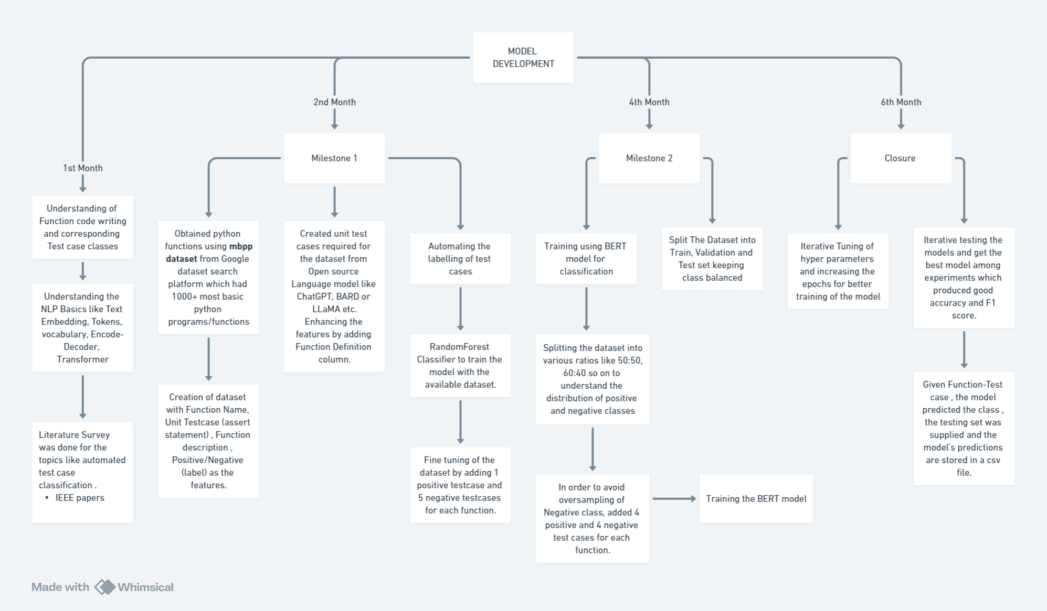
Approach / Solution -
Concept Diagram : Flow chart

Slide 4
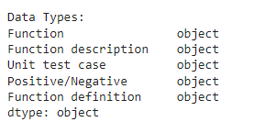
Dataset(s) Analysis / Description
Dataset Capture / Preparation / Generation :
The Python functions in the dataset are taken from mbpp dataset obtained from Google Dataset Search Platform.
Link : https://github.com/google-research/google-research/blob/master/mbpp/mbpp.jsonl
Preparation of the dataset with Function Name, Test Case statements (assert statements only) , Function description and Positive/Negative(label) as features in the initial phase followed by the inclusion of Function definition column and slight modifications in the Unit Test case column in the next phases.
For each python function, there are equal number of positive and negative unit test cases along with their labels (positive / negative) in order to achieve balance in the dataset.
Dataset Understanding / Analysis :
The dataset consists of Non- numeric data (text) where Positive/Negative is the target column.
Function, Function_description, Unit_test_case, Positive/Negative, Function_definition
are the features present in the dataset.
Equal distribution of Positive and Negative classes in the dataset to prevent imbalance in the dataset.
Each python function has four positive and four negative unit test cases.
Dataset Pre-Processing / Related Challenges (if any) :
Handling the missing values by replacing it with the mode (frequently occurring one) or removing the entire row/column if the number of missing values in a row/column is proportional.
Initially the dataset had 1 positive test case and 4 negative test case for a function which lead to imbalance . This was rectified by increasing the positive test cases to 4 and decreasing the negative test cases to 4 leading to equal distribution of the two classes.

Slide 5
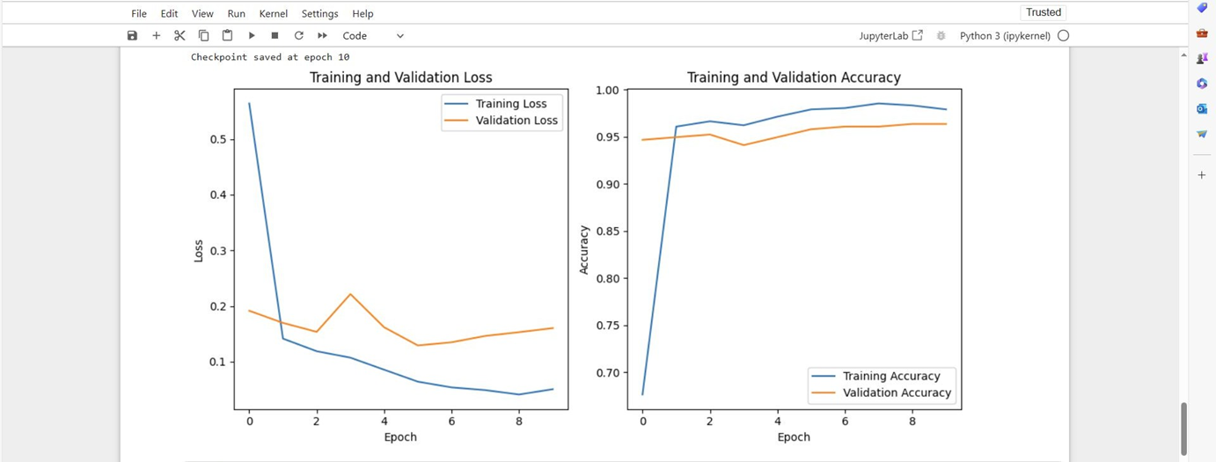
Experimental Results / Simulations / Observations
Results :
Plot for Accuracy and Loss

Slide 6
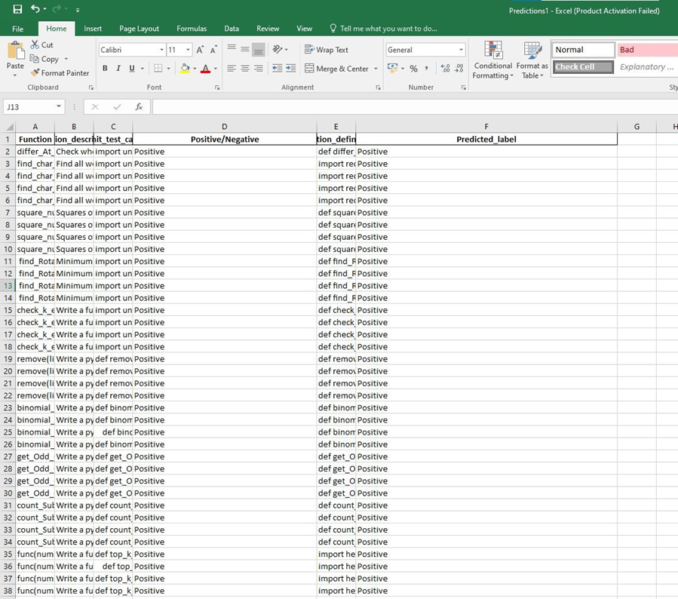
Experimental Results / Simulations / Observations
Predictions for
the test dataset

Slide 7
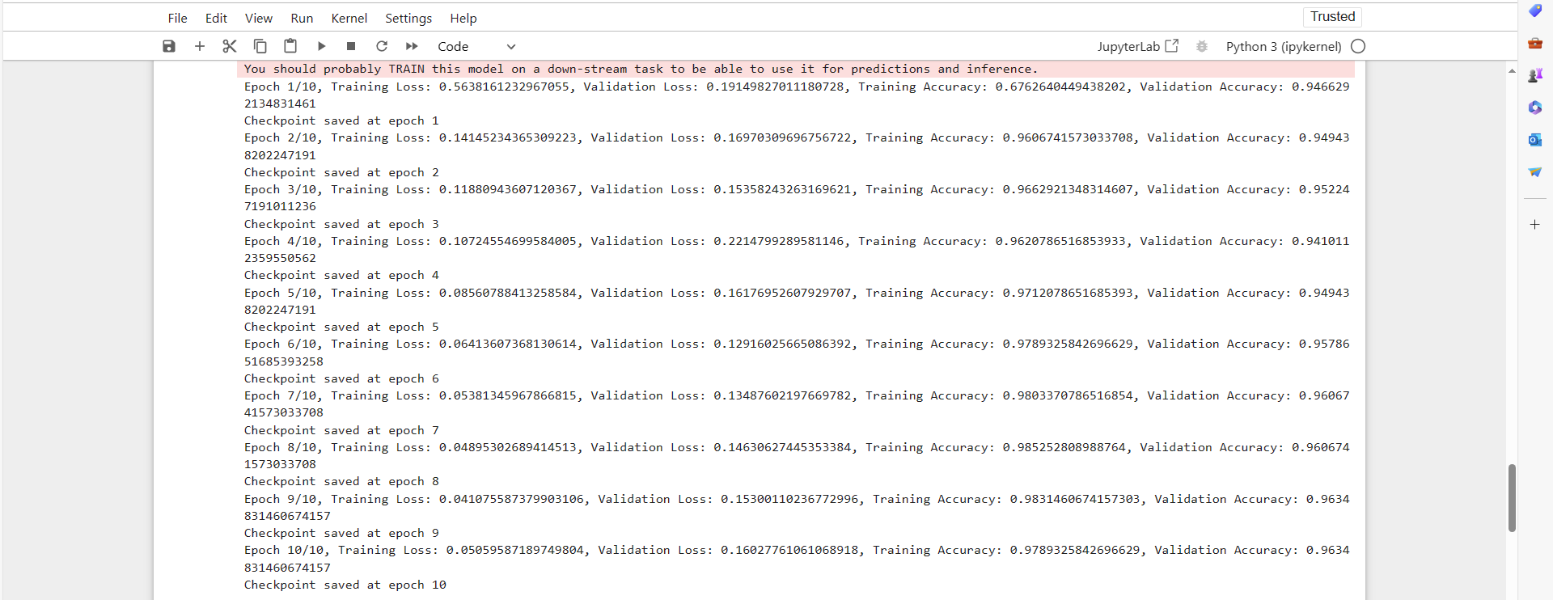
Experimental Results / Simulations / Observations

Slide 8
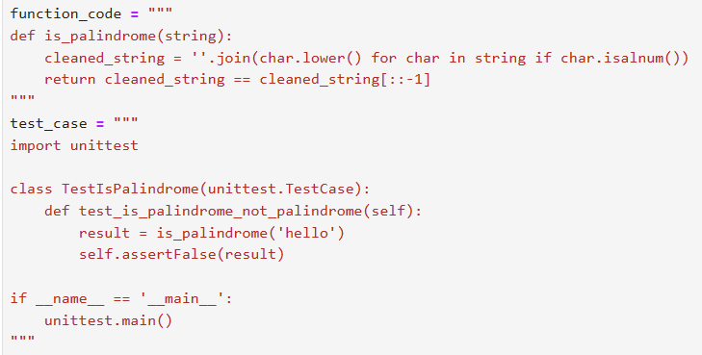
Experimental Results / Simulations / Observations

Slide 9
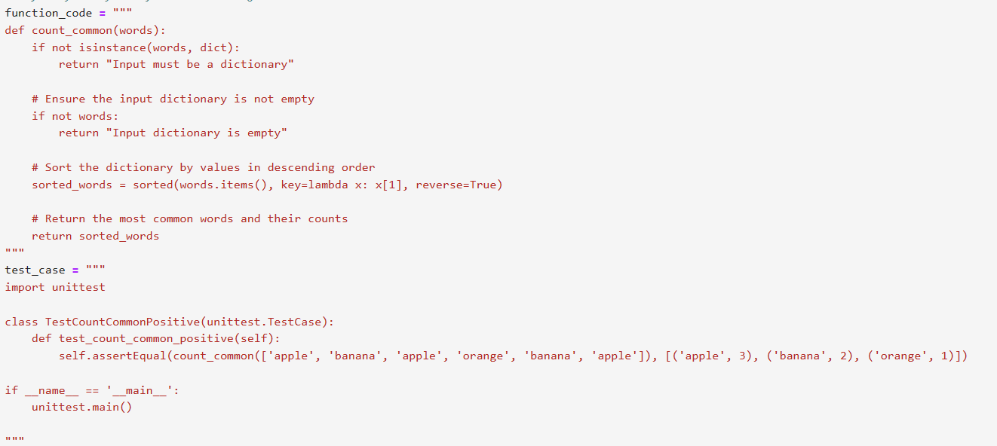
Experimental Results / Simulations / Observations

Slide 10
Experimental Results / Simulations / Observations
Major Observations / Conclusions & Challenges :
Done the literature survey [ referred the IEEE papers ]
Dataset Preparation:
Collection of relevant dataset from open source - mbpp dataset [From Google dataset Search] was relevant to the problem statement.
Mbpp dataset consist of only python functions so Open source Language model like ChatGPT, BARD or LLaMA etc. were used to generate the test cases and automation of labelling was done.
A dataset with the features function name ,function description, testcase , label [Positive / Negative] and the python functions were kept in a separate document.
Asked to add the function code in the dataset itself.
Modified the dataset that has the features - function name, function description, testcase , label[Positive/Negative] , function code.
1:5 ratio for positive and negative test cases. - industry practice was asked to follow.
Function body was added to Unit test cases.
All the fine tuning of dataset was done.
Trained the Model using BERT:
Since the dataset was composed of testcases in the ratio of 1:5[Positive:Negative] , the model got overfitted towards negative. In order to resolve this issue the dataset was modified to testcases in the ratio of 4:4[Positive:Negative]

Slide 11
Deliverable
Final Deliverables :
Dataset with features - Function, Function_description, Unit_test_case, Positive/Negative, Function_definition and the positive and negative test cases are in the ratio of 4:4.
BERT Model that takes python function and testcase as input and gives the predicted label [ Positive / Negative ] as output.
IP / Paper Publication Plan :
The record of all the changes in the dataset , model ,outputs are documented as of now. Currently we are working on the formatting of the paper to be published in IEEE format.
Deadline Requested - First week of May 2024
KPIs delivered/Expectations Met:
•Created dataset for Python Language which consists of :
Function, Function_description, Unit_test_case, Positive/Negative, Function_definition
•Augmented the dataset to increase the dataset and balanced positive and negative class count
•Verified and Validated dataset classes
•Found and Trained Suitable Language model/Custom Generative model (BERT) for classification task
•Tuned the hyper-parameters to get Accuracy>60% and F1 Score>50%

Slide 12
Work-let Closure Details
Code Upload details:
Items | Details
KLOC (Number OF Lines of codes in 000’s) | 163 LOC
Model and Algorithm details | BERT
Is Mid review, end review report uploaded on Git ? | Yes
Link for Git | https://github.ecodesamsung.com/SRIB-PRISM/PSG_23SE11_AI_ML_Dataset_creation_and_classification_of_Unit_test_cases
Data details (if applicable):
Items | Data folder 1
Name & Type of Data (Audio/Image/Video) | Textual Data
Number of data points | 3000
Source of Data (self collected, Scrapped, available on open source) | Self collected
Google drive link/ git link to access data | https://github.ecodesamsung.com/SRIB-PRISM/PSG_23SE11_AI_ML_Dataset_creation_and_classification_of_Unit_test_cases/tree/main/dataset

Slide 13
Thank you

